Slide 1
LAB-226 | Computer Organization & Assembly Language
Week 1 | 10 Feb, 25

Slide 2
Lab 1
Installation and setup of assembly programming environment.
Understanding of Compiler and emulator.
Understanding of basic registers.
Writing a Basic program.

Slide 3
1: Download Emu8086
Download link 1:
https://emu8086.en.lo4d.com/windows
Download link 2:
https://drive.google.com/file/d/1jzExZQlSQLncjBCRgWhg4a3eGZ9FxJnL/view?usp=sharing

Slide 4
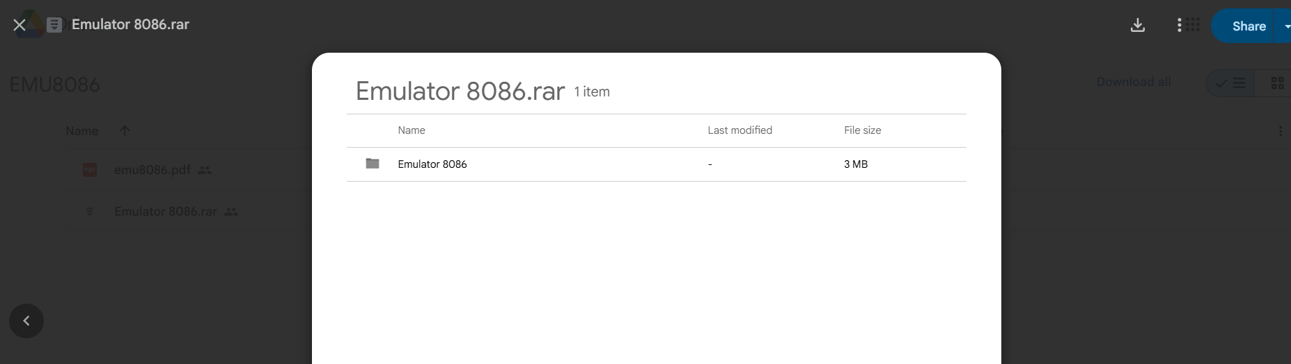
2: Download Emulator 8086.rar

Slide 5
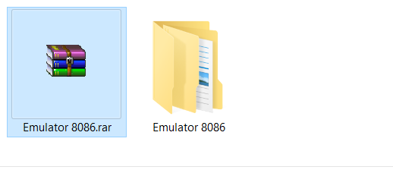
3: Extract Emulator 8086.rar file.

Slide 6
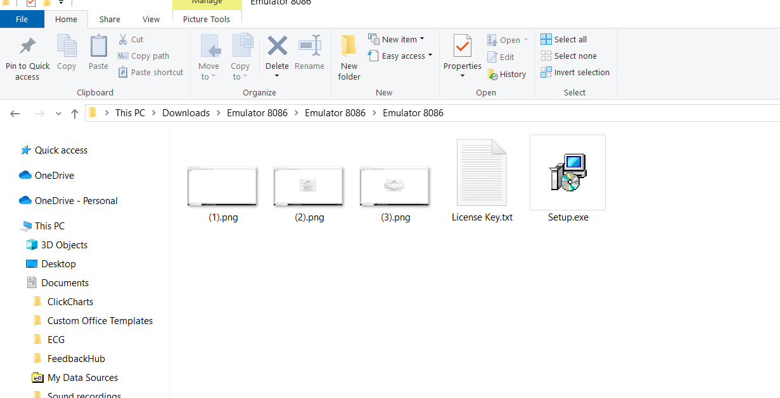
4: Click Setup.exe

Slide 7
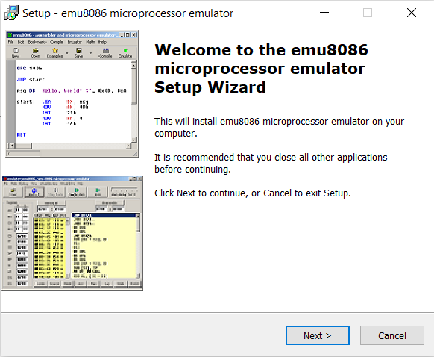
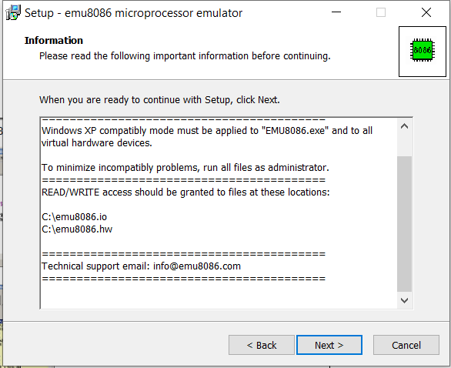
5: Emulator setup wizard

Slide 8
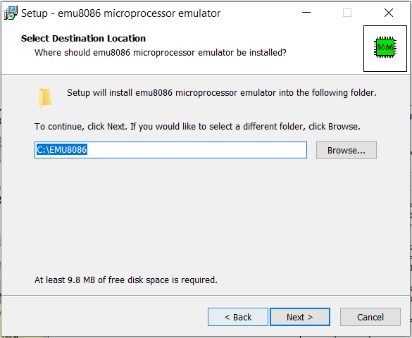
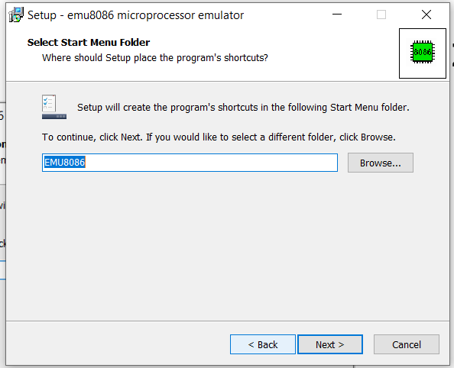
5: Emulator setup wizard

Slide 9
5: Emulator setup wizard

Slide 10
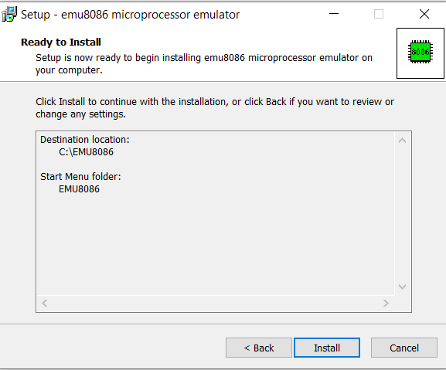
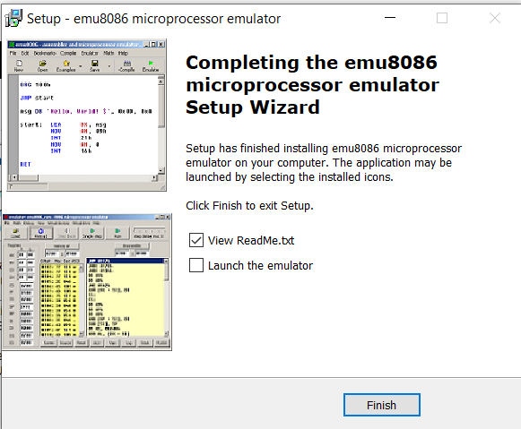
5: Emulator setup wizard

Slide 11
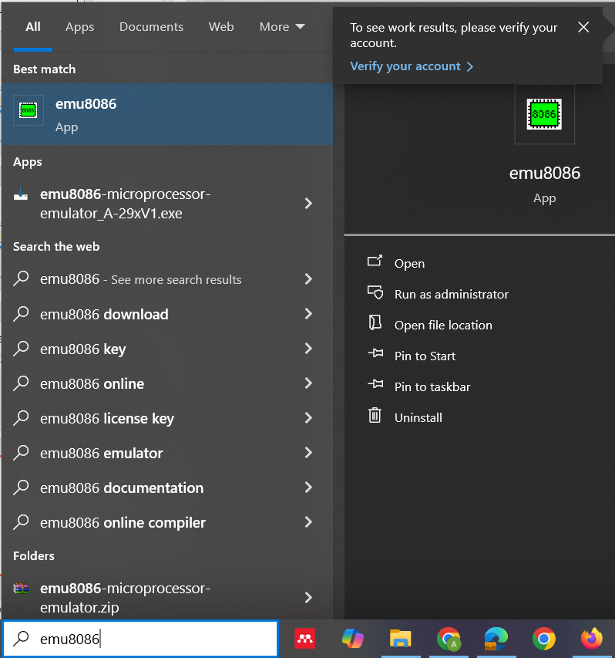
6: Launch emu8086

Slide 12
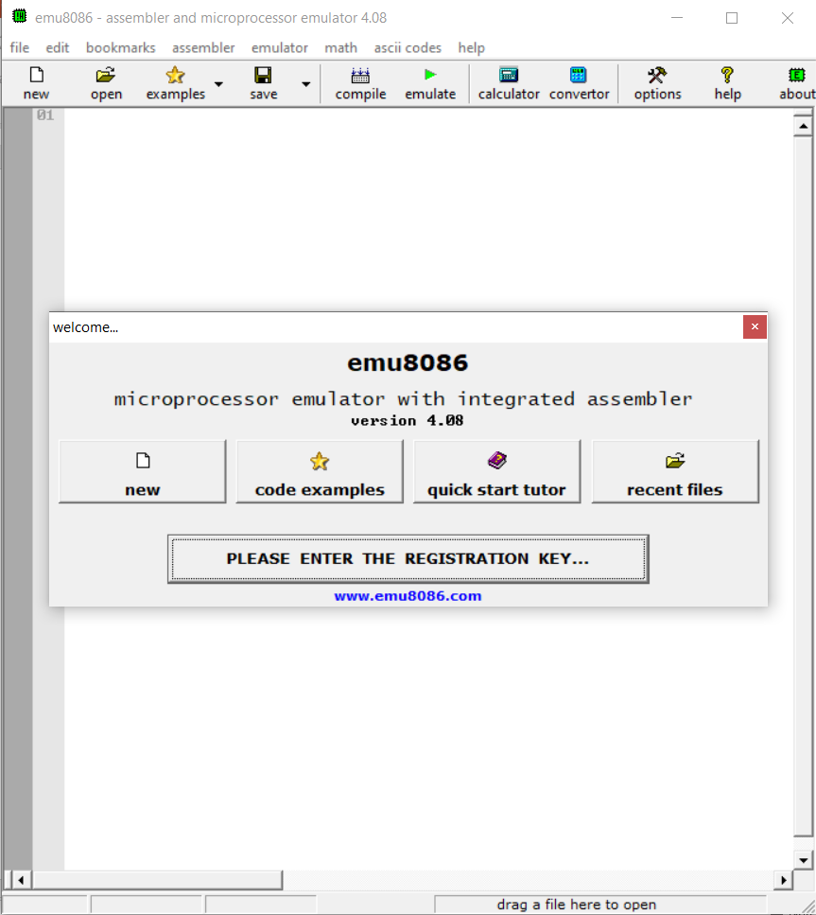
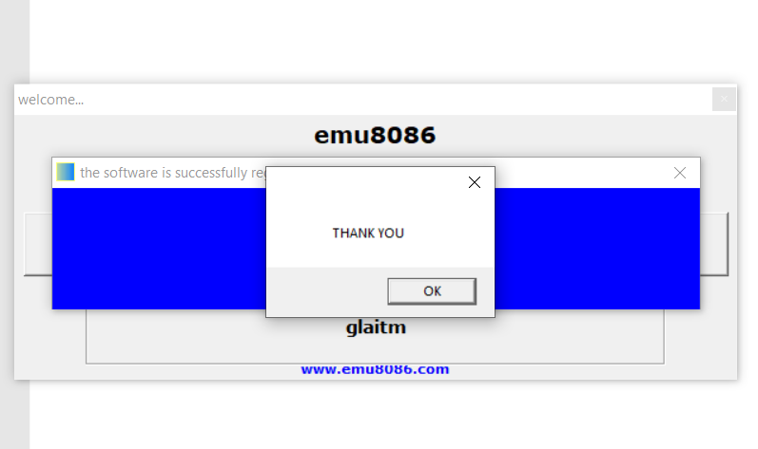
6: Launch emu8086
License Name: glaitm
Registration Key: 27R3VDEFYFX4N0VC3FRTQZX

Slide 13
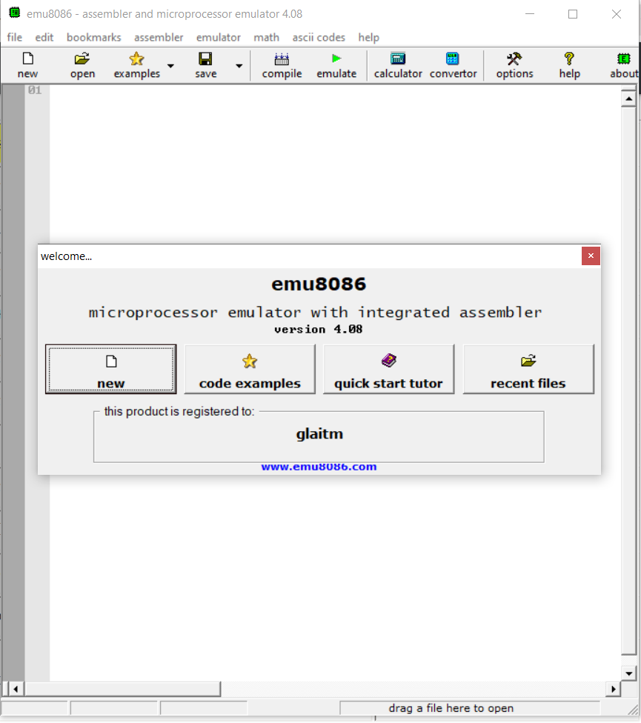
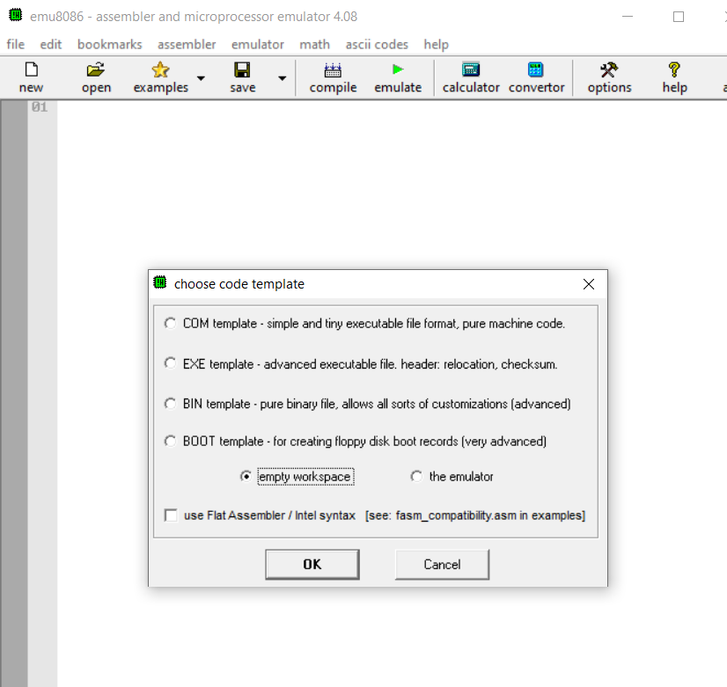
6: Launch emu8086
v
v

Slide 14
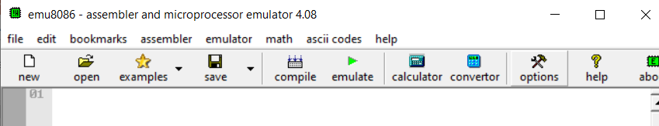
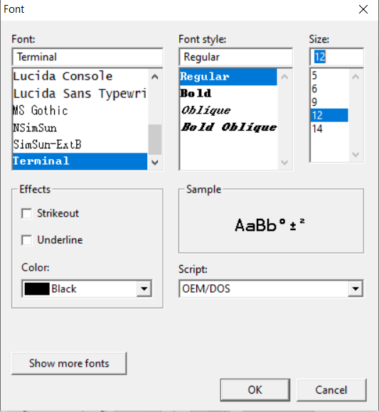
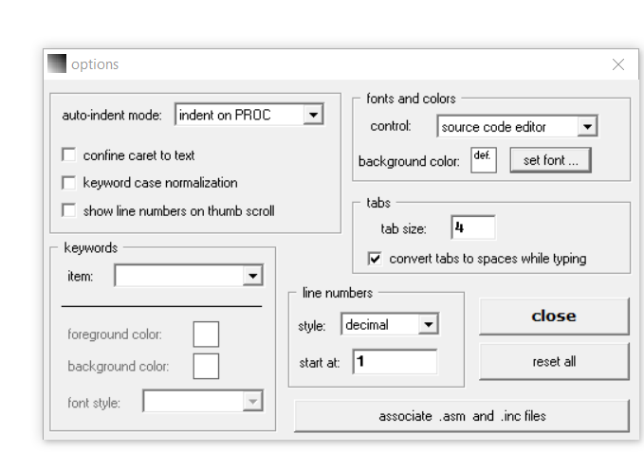
7: Working and Features
Increase font size for better readability of code.

Slide 15
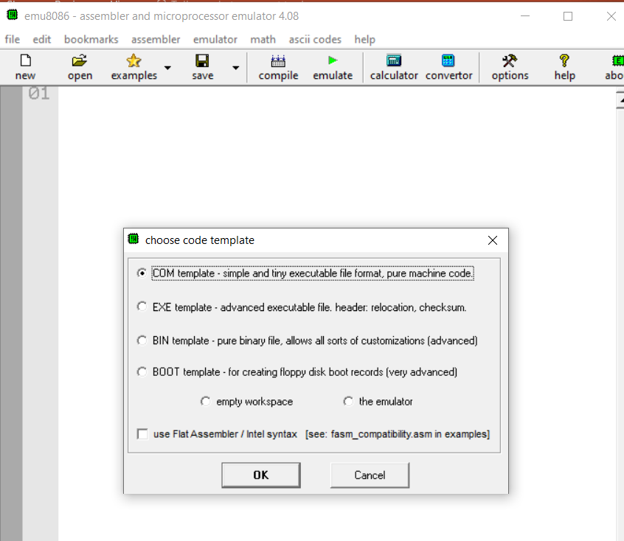
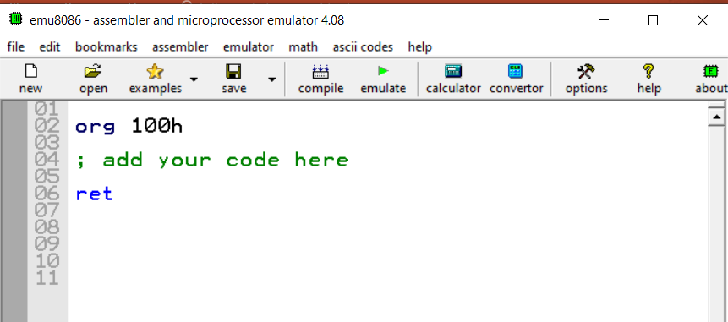
7: Working and Features
Create a new file using the COM template standard for the 8086. Click "Compile" to save the COM file, or choose "Save As" to save it with a filename ending in `.asm`.

Slide 16
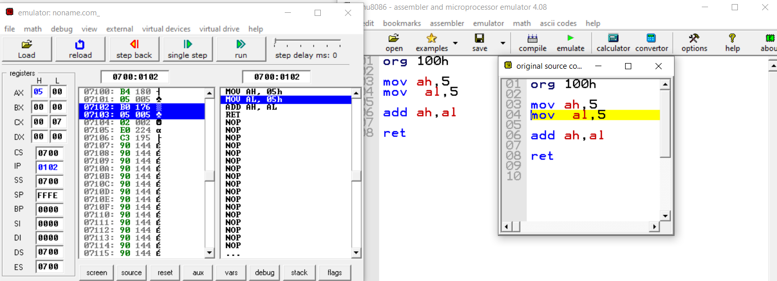
7: Working and Features
Type your code inside the text area, click[Compile] You will be asked for a place where to save the compiled file.
After successful compilation you can click [Emulate] button to load the compiled file in emulator.

Slide 17
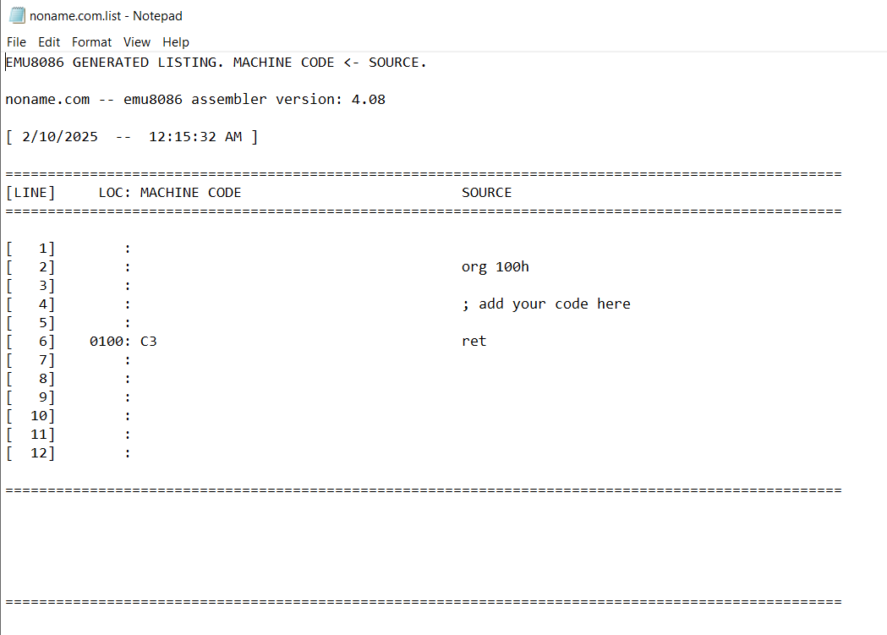
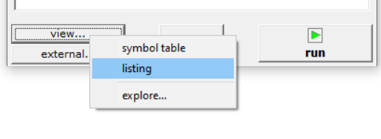
7: Working and Features
After successful compilation explore listing file.

Slide 18
7: Working and Features
In Emu8086, a listing file is a detailed output file that includes both the assembly source code and the corresponding machine code generated during compilation.

Slide 19
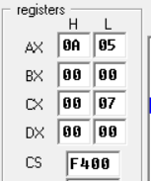
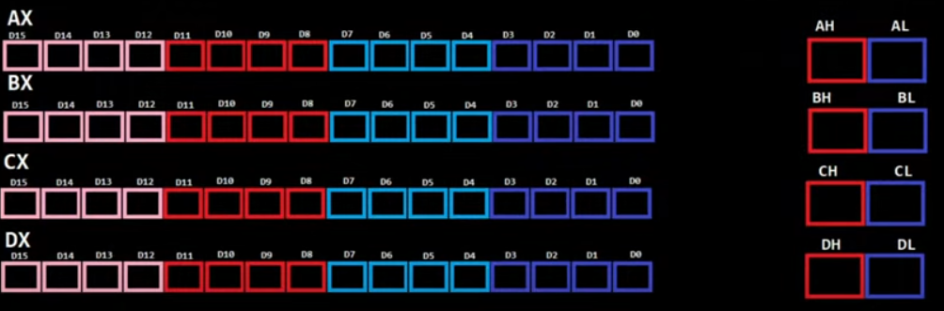
8: General Purpose Registers
8 bit
8 bit
1 Word =
16 bits (2 bytes) in a 16-bit system.
32 bits (4 bytes) in a 32-bit system.
64 bits (8 bytes) in a 64-bit system.
4bit
4bit
1 nibble a four-bit aggregation

Slide 20
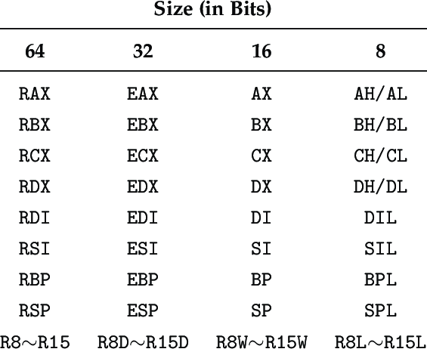
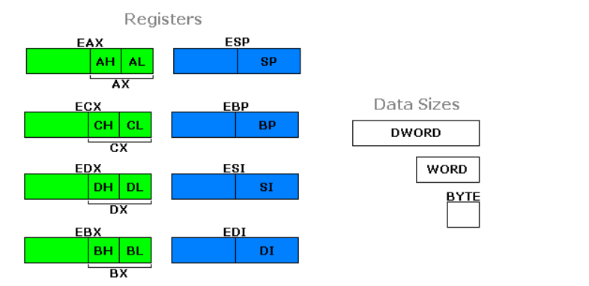
8: Registers Slicing
You can think of the small registers as being pieces (or slices) of the big ones.

Slide 21
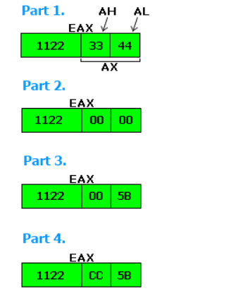
8: General Purpose Registers Working
MOV EAX,11223344 ;Store hex number 11223344
to EAX.
MOV AX,0 ;Store 0 to AX,
MOV AL,5B ;Store 5B to AL,
MOV AH,CC ;Store CC to AH,

Slide 22
Task 1
Write a program to add two numbers.

Slide 23
Submission guidelines
Submit a screenshot of the emulator and output window on GCR, including your name and ID. Additionally, submit the code using Notepad.

